Slide 1
DCAITI-Project:
Intelligent rear-view mirror for cyclist on Smartphones
Oday Kabha oday.kabha@ipk.fraunhofer.de
Shan Han hanshann09@gmail.com
name @mailbox.tu-berlin.de
Supervisor: Macus
Notes:
1

Slide 2
Overview
Idea
Develop Framework
System Architecture
Solution Approaches opproaches
Milestone
2
18.11.2020
DCAITI -Projekt

Slide 3
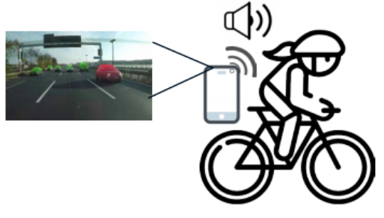
1. Idea
Object Detection & Tracking:
Smartphone cam
Additional cam
Image processing Algorithms
Measurement of Distance & Speed:
Simple smartphone cam using image processing algorithms
LiDAR
Notifications & Warnings
When objects too close or too fast
Android Notification Receiver
Source: Introduction slides of Marcus
3
04.05.2021
DCAITI -Projekt
Notes:
3

Slide 4
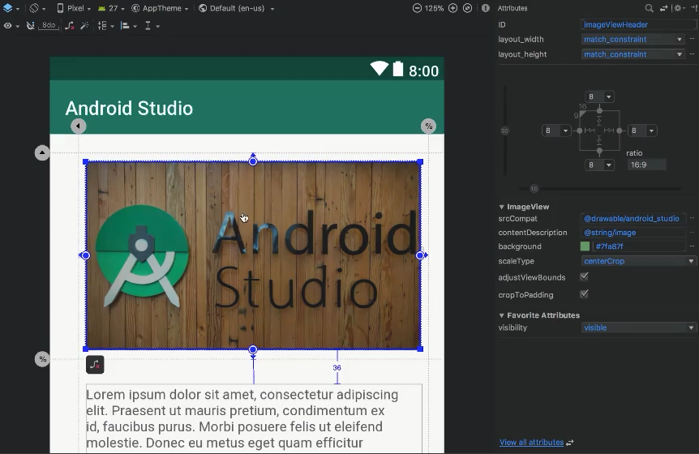
2. Develop Framework
Android Studio
Visual layout editor
build layouts by dragging UI elements instead of writing layout XML by hand
Source: https://developer.android.com/studio
4
04.05.2021
DCAITI -Projekt

Slide 5

2. Develop Framework
Android Studio
Fast emulator
run apps on the Android Emulator
Source: https://developer.android.com/studio
5
04.05.2021
DCAITI -Projekt
Notes:
5

Slide 6
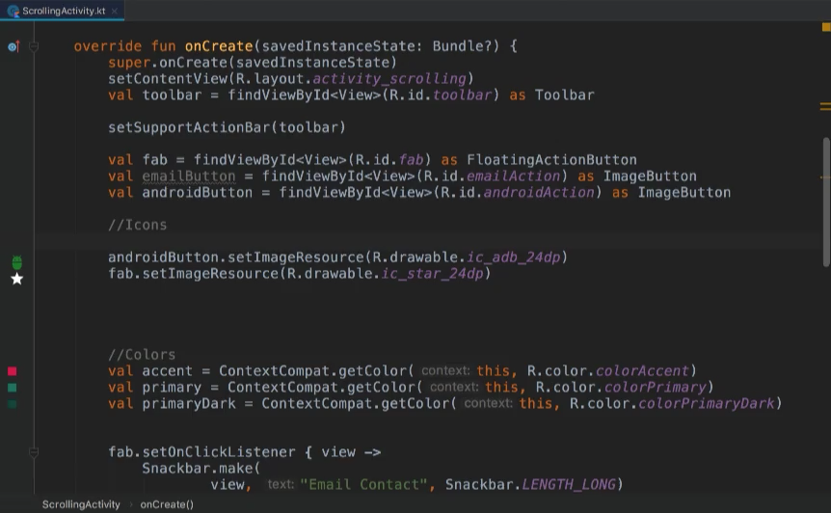
2. Develop Framework
Android Studio
3. Intelligent code editor
based on IntelliJ IDEA
Source: https://developer.android.com/studio
6
04.05.2021
DCAITI -Projekt
Notes:
6

Slide 7
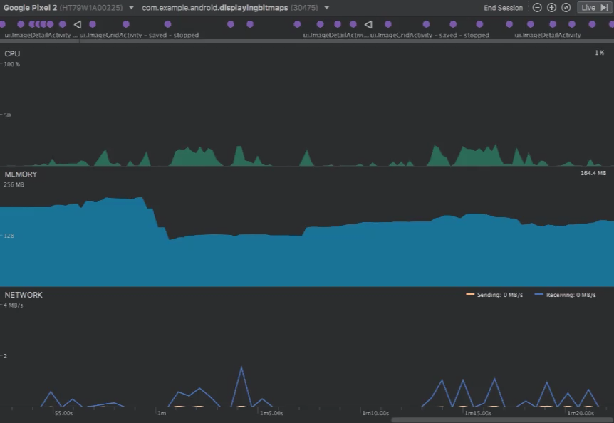
2. Develop Framework
Android Studio
4. Realtime profilers
measure app performance
Source: https://developer.android.com/studio
7
04.05.2021
DCAITI -Projekt
Notes:
7

Slide 8
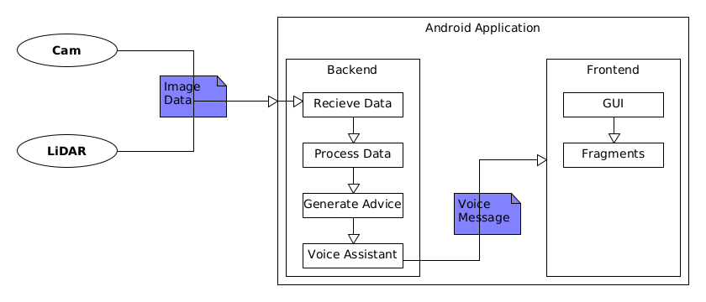
3. System Architecture
8
04.05.2021
04.05.2021
DCAITI -Projekt
DCAITI -Projekt

Slide 9
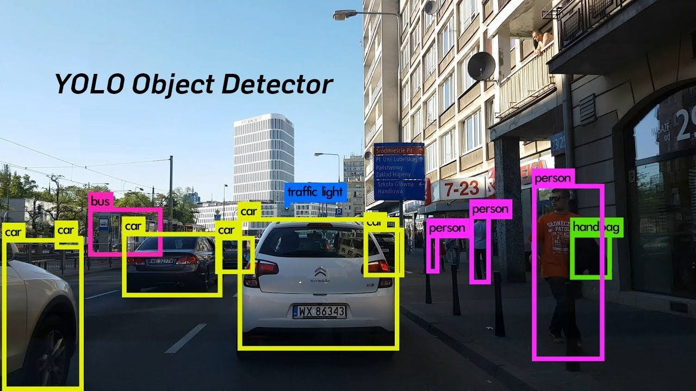
4. Solution Approaches
Vehicle Detection
YOLO (You only look once)
MaskRCNNs
Detectron2
9
04.05.2021
DCAITI -Projekt

Slide 10
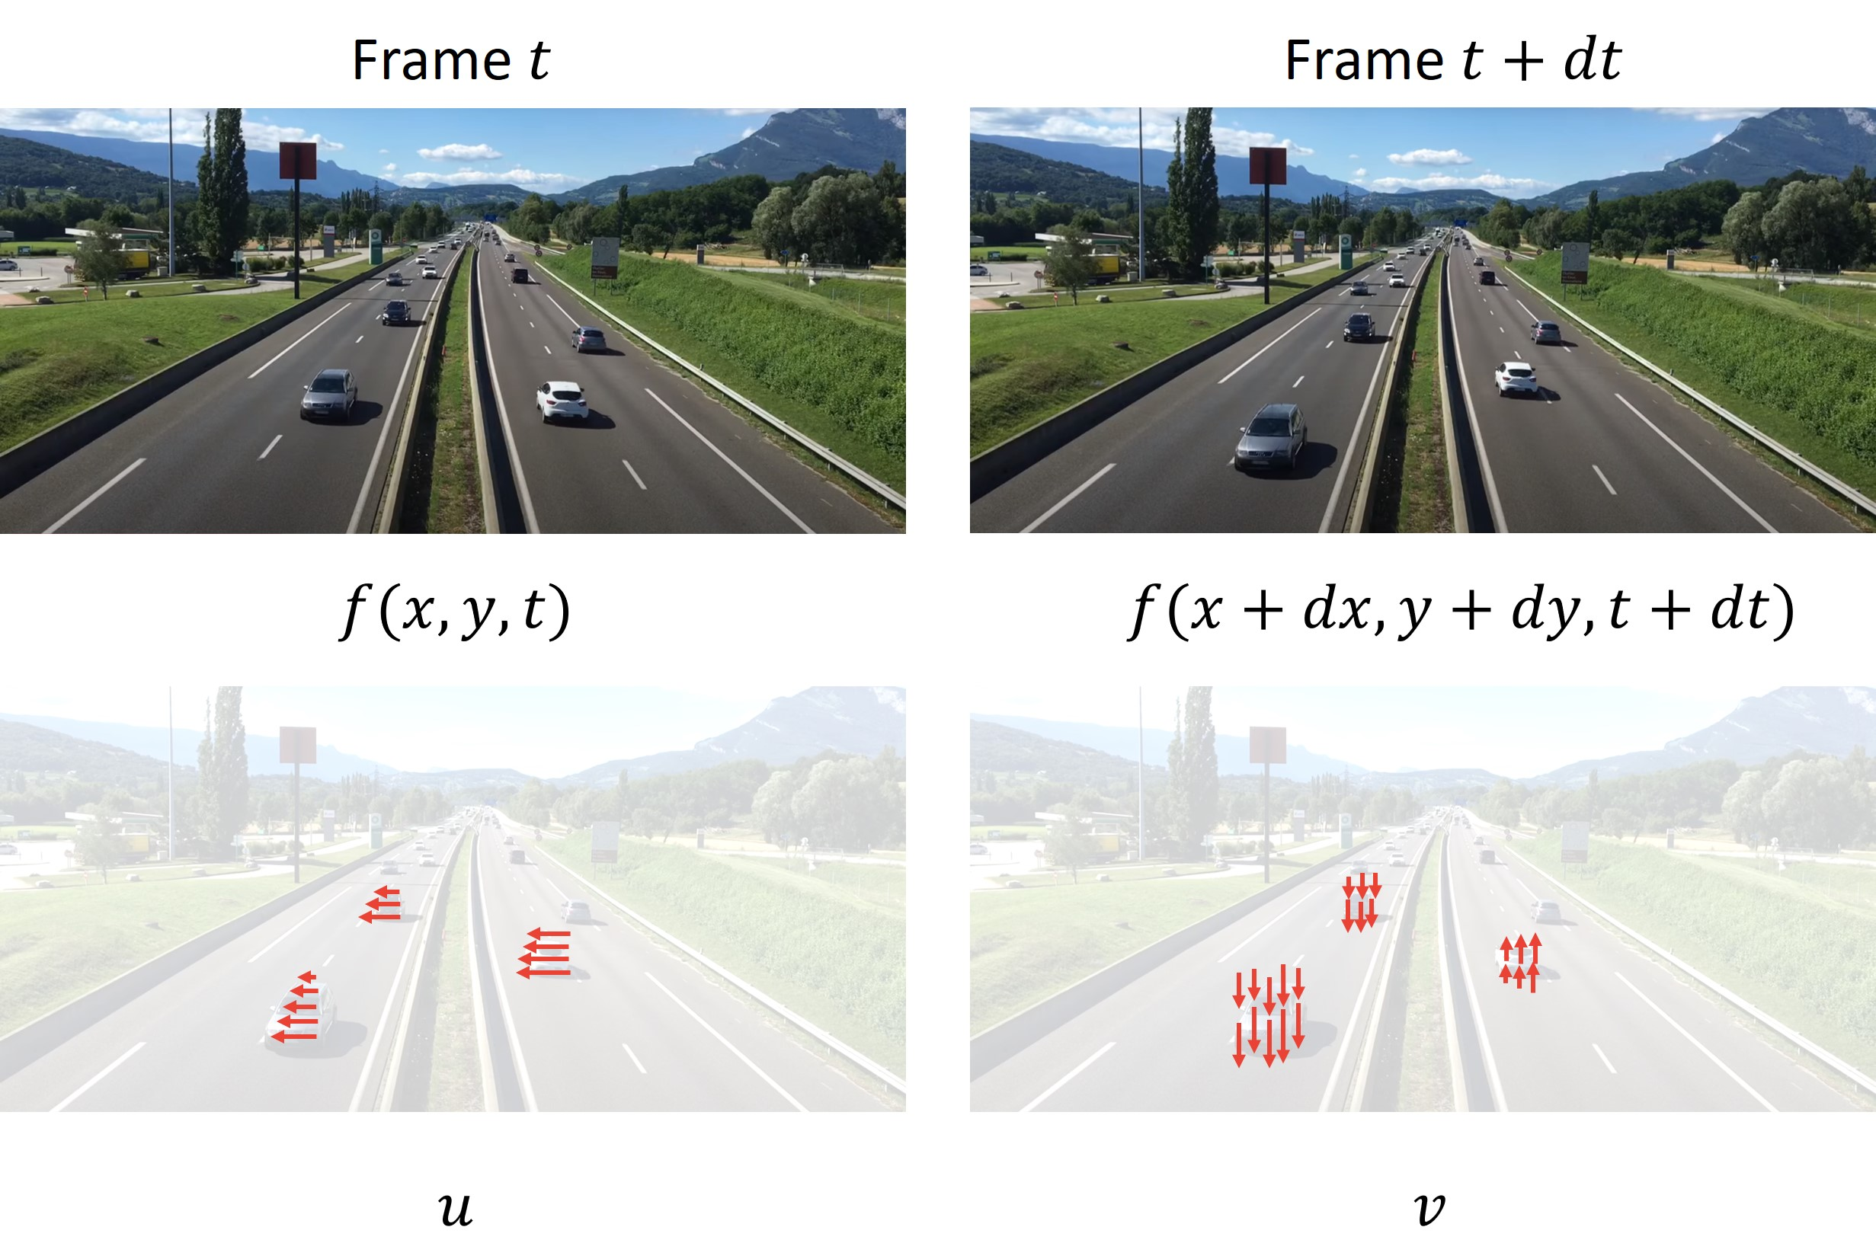
4. Solution Approaches
Tracking
Sparse Optical Flow
Lucas-Kanade-Methode
Elementary Motion Detector
10
04.05.2021
DCAITI -Projekt

Slide 11
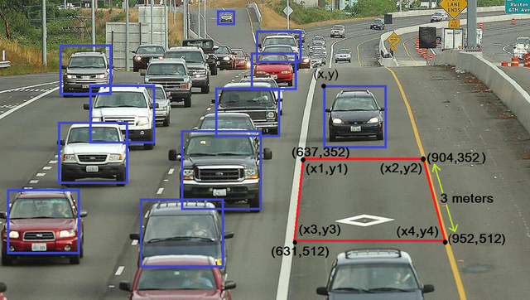
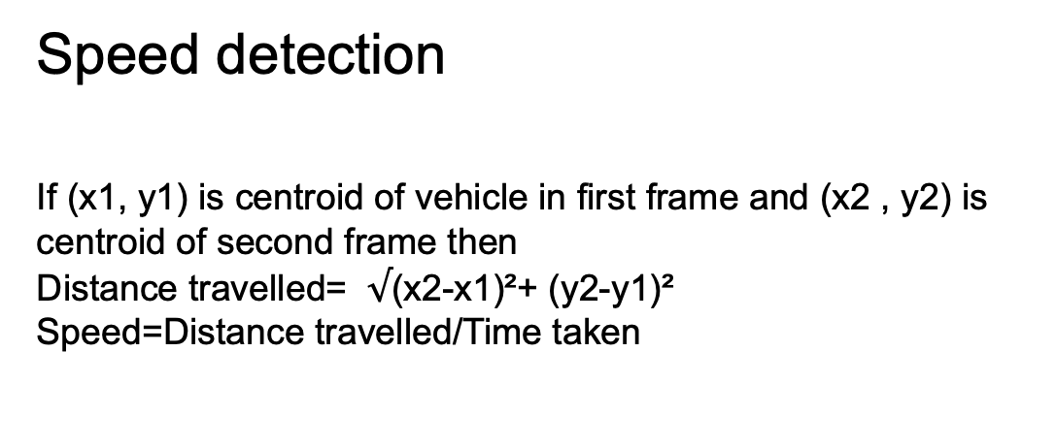
4. Solution Approaches
Speed detection
If (x1, y1) is centroid of vehicle in first frame and (x2 , y2) is
centroid of second frame then
Distance travelled= $√$(x2-x1)²+ (y2-y1)²
Speed=Distance travelled/Time taken
11
04.05.2021
DCAITI -Projekt
Notes:
Distance is calculated using the centroids of previous and next
frames. For distance calculation, Euclidean distance is used.
Time is calculated as vehicle enters the ROI. Initially the
speed is calculated using the formula

Slide 12
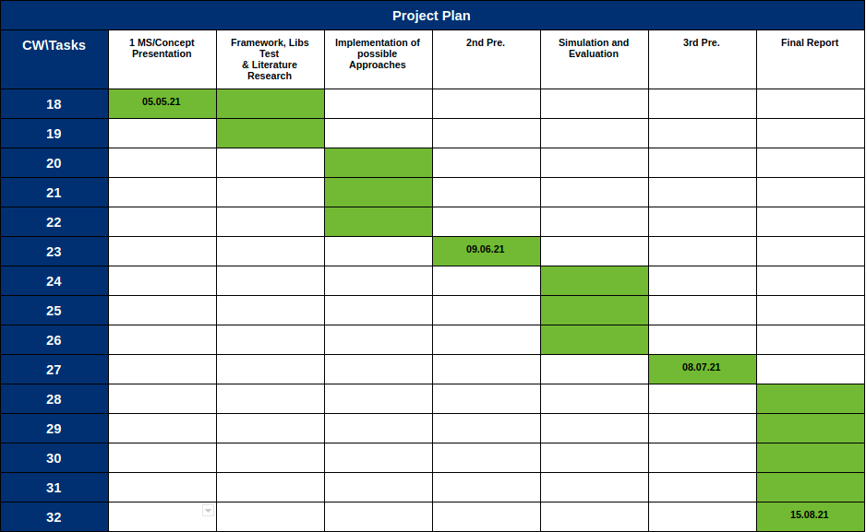
3. Milestone
12
04.05.2021
DCAITI -Projekt

Slide 13
Thanks for your attention!
Oday Kabha oday.kabha@ipk.fraunhofer.de
Shan Han hanshann09@gmail.com
name name@mailbox.tu-berlin.de
Notes:
13

